Slide 1
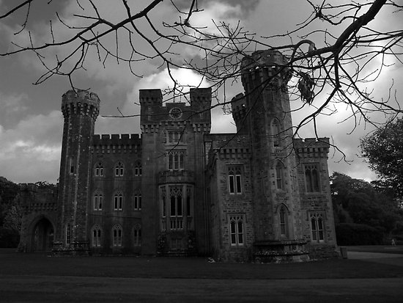
Supernatural Tourism
The Scariest Places on Earth

Slide 2
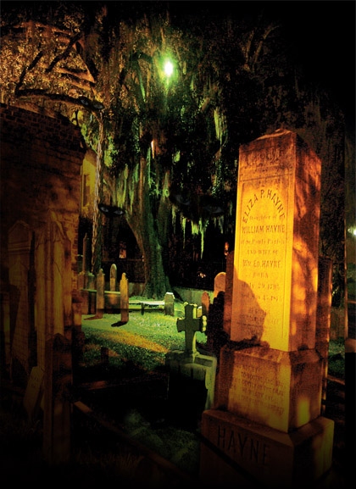
Ghost Tourism
Ghost tourism has boomed over the past decade, propelled by the public's interest in the mysterious and supernatural.
People will travel to haunted landmarks or even stay in purportedly haunted hotels

Slide 3
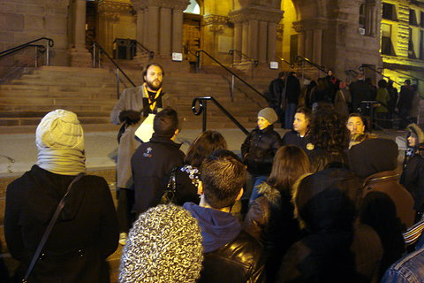
Ghost Tours
Very popular are “Ghost Walking Tours”. These are available in most big cities in North America and many places worldwide.
A usually costumed tourguide will walk with a group of people around an area at night and tell them all about the scary ‘true’ stories and a bit of local history.

Slide 4
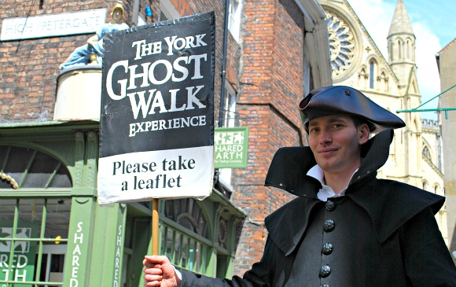
Popular in October
Unlike haunted houses, ghost tours are available all year long
Of course demand for tickets really spikes around Halloween

Slide 5
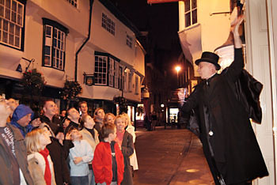
Growing Industry
Ghost tourism is worth an estimated $300 million a year
This has skyrocketed in the last 15 years from what used to be a novelty.
Those big profits have caught the attention of municipalities in need of new revenue.

Slide 6
What Makes a City a Good Place for Ghost Tourism?

Slide 7
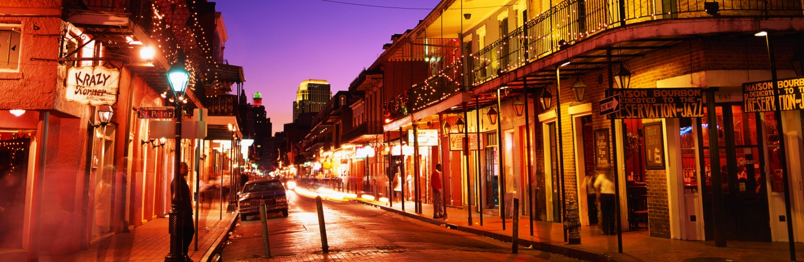
1) A long history of tragedy
  New Orleans gets a lot of ghost tourism
  They’ve had a high concentration of ghastly deaths throughout their history.
  “We’ve had to deal with everything from cannibals to quicksand to alligators, snakes, a high murder rate, two major catastrophic fires in the late 1700s that destroyed the entire city, and over 27 yellow fever epidemics.”

Slide 8
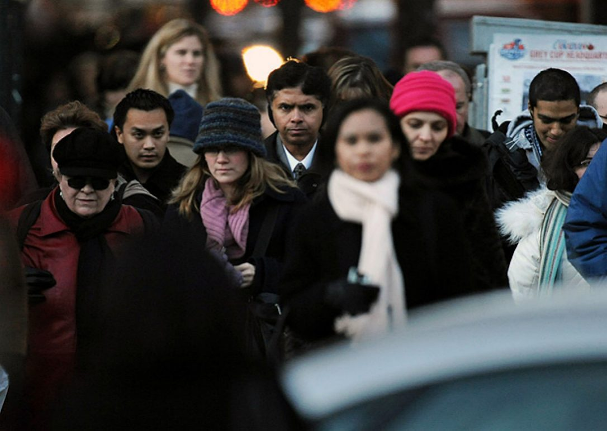
2) Diverse Population
Whenever you have different cultures together, you get storytelling.
Vegas is no one’s idea of a cultural stew.
And while Los Angeles is a city of transients, few stick around long enough to be part of the inter-generational game of Ouija.

Slide 9
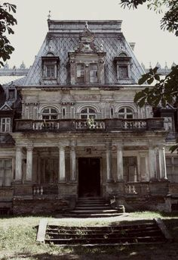
3) The city looks scary
Neither Vegas or Los Angeles look scary.
The aesthetics of a city figures largely when it comes to starting a ghost tour.
Walking through the French Quarter evokes more feelings of dread than strolling under the glittering lights of the Vegas Strip

Slide 10
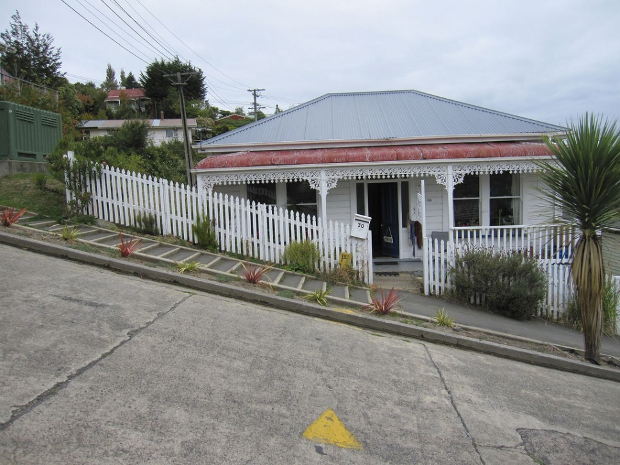
4) The city is walkable
The topography needs to be considered, too.
New Orleans is flat and easily walkable, San Francisco is all hills.
Walking tours need to be easy.

Slide 11
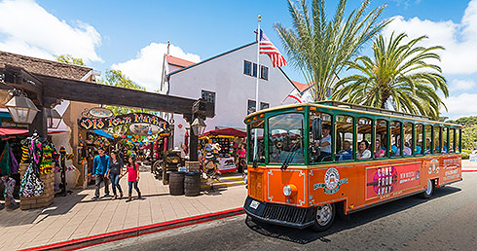
5) The historic district needs to be active & vibrant & safe
San Diego’s Old Town has a lively bar scene
Savannah closes early but has a walking population throughout the night
Being in an active neighborhood, of course, leads to the most important reason that ghost tours are around: Tourists.
They need to feel safe.

Slide 12
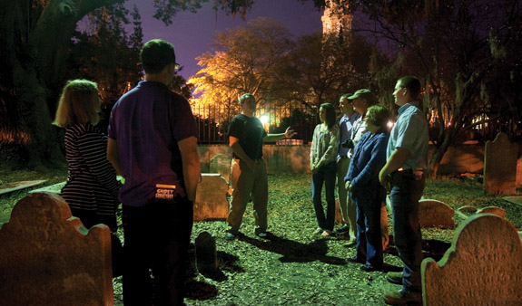
Ghost Tourism = $$$
Becoming a licensed tour guide is easy: You pay a fee, get a license, and take the tour guide’s test
Ghost tours can be a very lucrative business: It is a service with little overhead and start-up costs.
Tickets for a ghost tour often cost $10 to $30 or more per person.
With a large group, a good storyteller can make $500

Slide 13
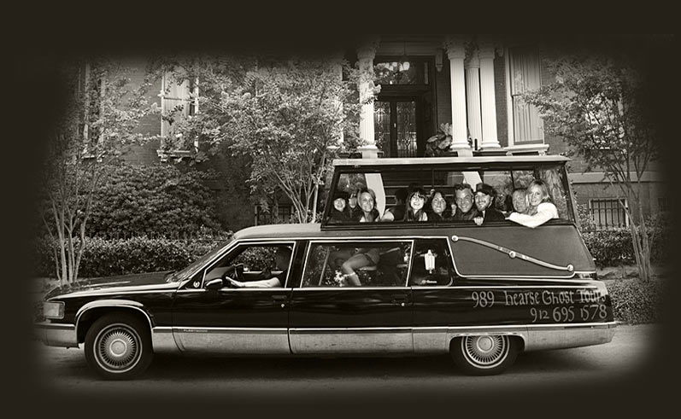
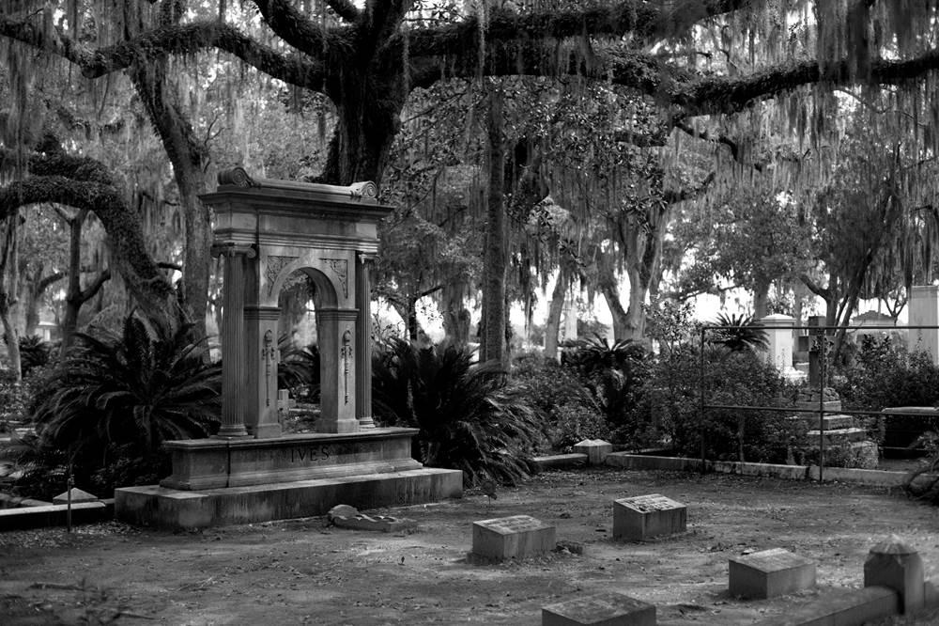
Example: Savannah, Georgia
Like any business, competition can lead to some intense moments.
47 ghost tours there
City population: 132,000 people
12 million tourists annually
Once a tour-guide had a rival guide shoot rubber bullets at her

Slide 14
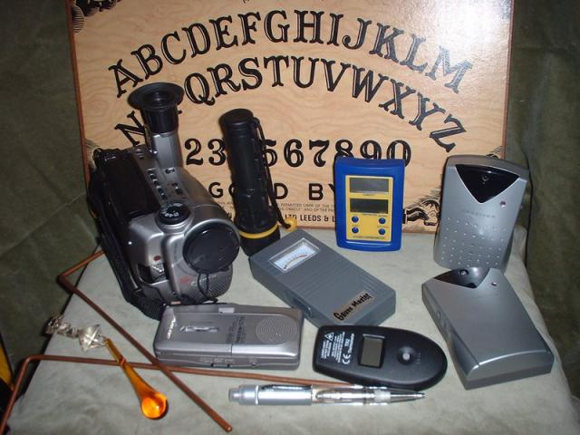
Ghost Tours vs Ghost Hunting
Ghost tours = walking around listening to a historian
Ghost Hunting = using specialized equipment to seek out evidence of ghosts

Slide 15
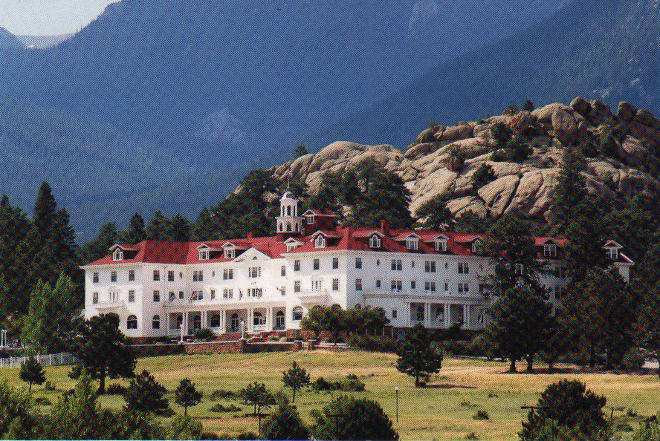
Haunted Hotels
Hotels are cashing in on their supernatural credentials.
Colorado’s Stanley Hotel, the hotel that inspired “The Shining”, offers ghost tours and a “Ghost Adventure” package starting at around $283/night
The hotel was on the verge of bankruptcy before it was featured in a 2006 episode of the Syfy program Ghost Hunters.
You can upgrade to a haunted room upon check-in
The hotel also reassures would-be guests that they only host “happy ghosts.”

Slide 16
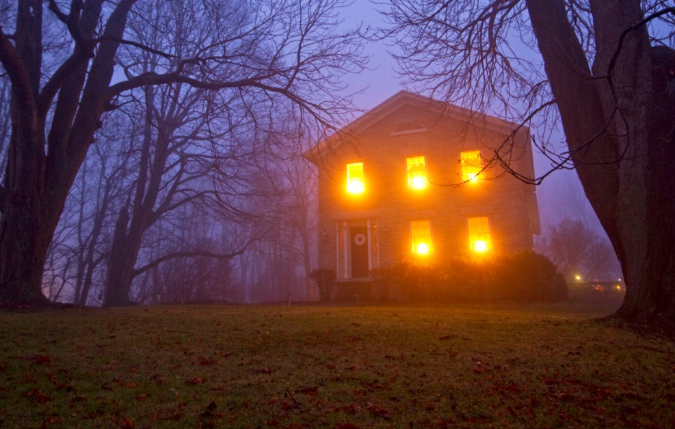
Everyone Wants In On This Trend
Before, businesses did not want to have ghostly rumours swirling around them; bad for business
But now hotels, restaurants and even entire Canadians cities are clamouring to prove that they are swarming with the lost souls of the dead.

Slide 17
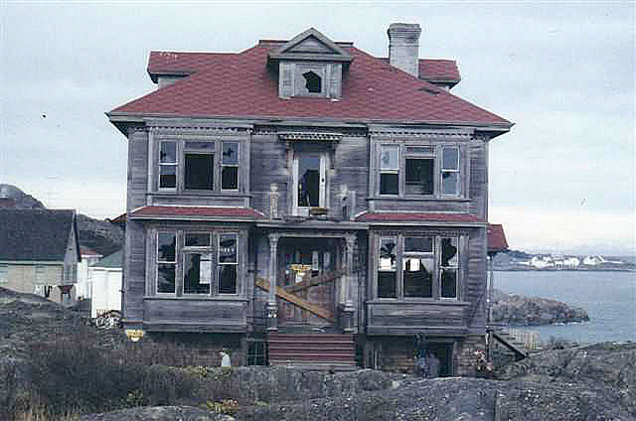
Example: Victoria, BC
Tourism promoters in Victoria, B.C., have picked this Halloween to brand itself hard as British Columbia’s “most haunted city.”
Now more and more places are quite willing to admit they’re haunted, and also promote the fact

Slide 18
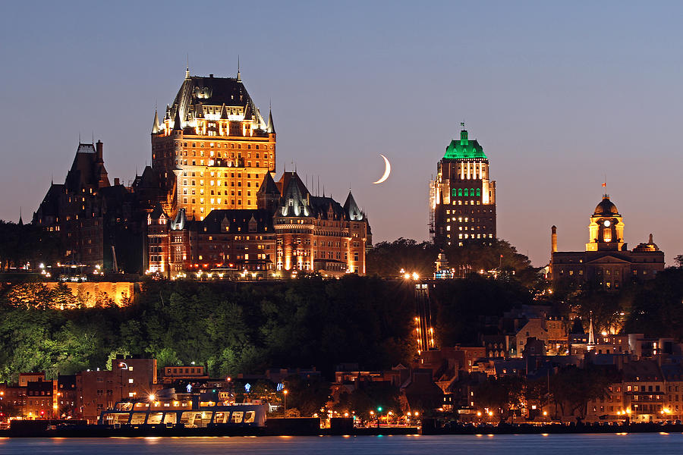
More Canadian Businesses Want In
Canada’s former railway hotels are often ground zero for a city’s ghost stories.
While the esteemed hotels once resisted their association with spectral purgatory, Fairmont Hotels and Resorts now boast that their spirit guests “never want to leave.”

Slide 19
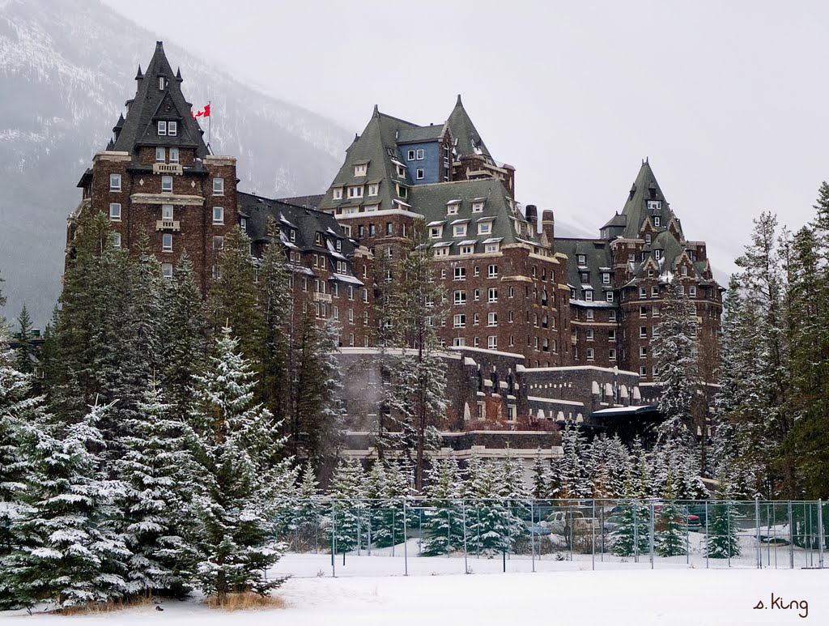
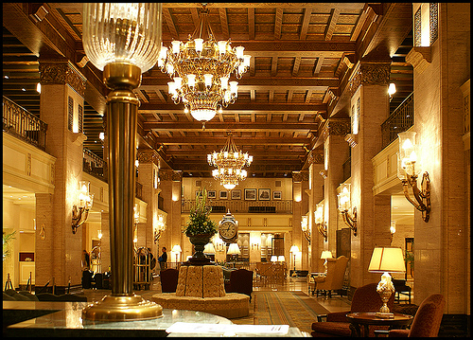
Haunted Canadian Hotels
Banff Springs Hotel in Alberta has 2 famous ghosts; a bellman and a bride
The Fairmont Royal York in Toronto has a haunted ballroom
The Delta Bessborough in Saskatoon has a man who will smile at you in the banquet hall before disappearing

Slide 20
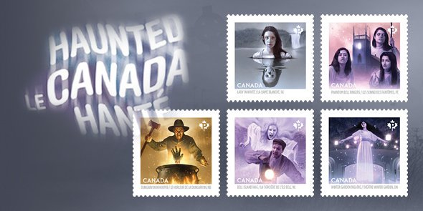
Even the Government Wants In
Parks Canada leads ghost tours of the Halifax Citadel and Saskatchewan’s Fort Battleford
Canada Post released a set of five stamps commemorating Canadian stories of “apparitions, eerie sounds, phantom lights and spirits trapped between this world and the next.”

Slide 21
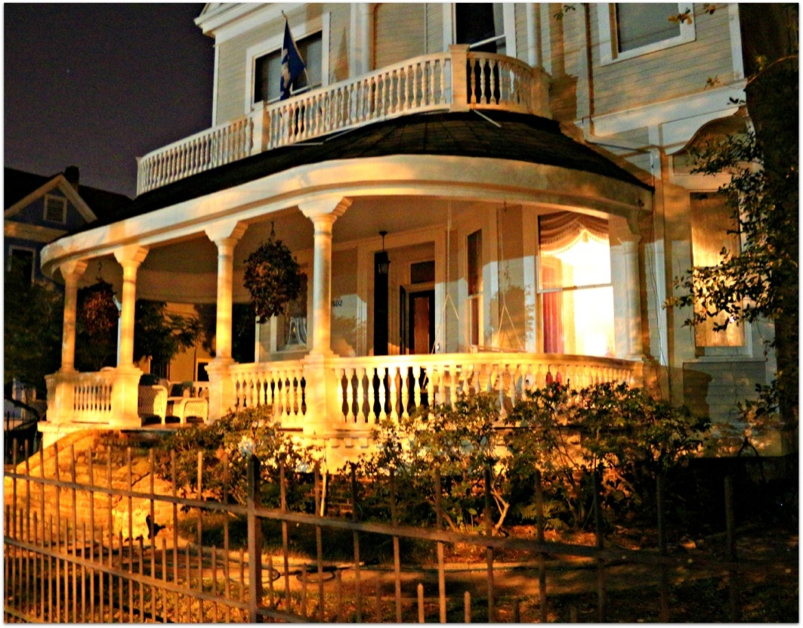
Popular Haunted Towns
Salem, Massachusetts, exploits its infamous witch trials of the 1690s
Tourists, goths, and wannabe vampires flock to New Orleans, Louisiana, with its reputation for mysticism and voodoo

Slide 22
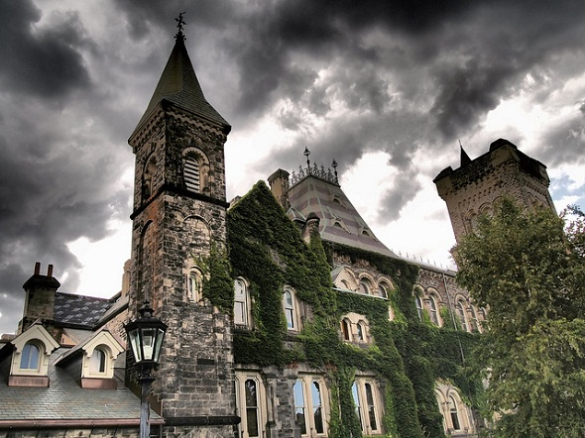
Haunted Toronto
There is a company that does ghost walking tours of downtown Toronto, the University of Toronto campus, the Distillery District, etc
Most of the oldest buildings, from Old City Hall to Queen’s Park are reportedly haunted

Slide 23
Haunted University of Toronto
Several of the older buildings are reportedly haunted, such as Hart House
In Christie Mansion at Wellesley/Queen’s Park a man is said to have trapped a woman in a windowless room there. Eventually the woman hanged herself.
Decades later, rumours persist that a woman entering the room alone late at night will find that the door suddenly swings shut behind her and refuses to open. To escape, she must pound on the heavy door until her rescuer is able to easily open it from the other side.

Slide 24
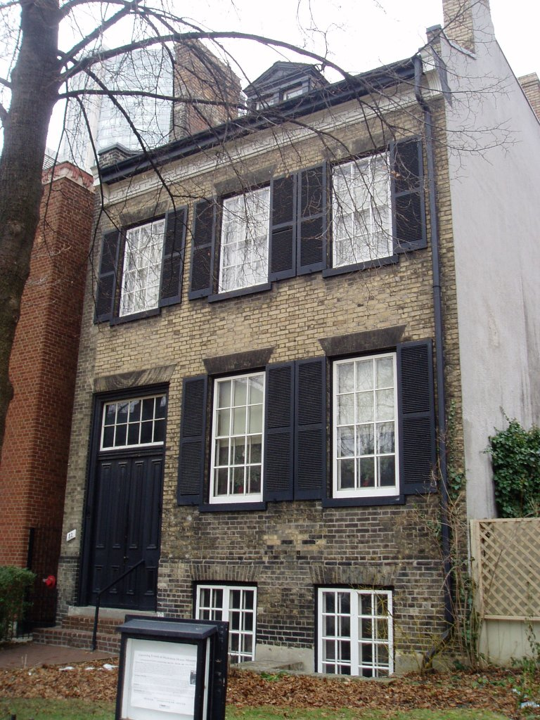
Other haunted places in Toronto
Mackenzie House (near the Eaton Centre), it belonged to the first mayor of Toronto
Fort York reportedly has a female ghost wandering around
The Keg Mansion is a haunted restaurant, creepy things have been reported in the upstairs bathroom

Slide 25
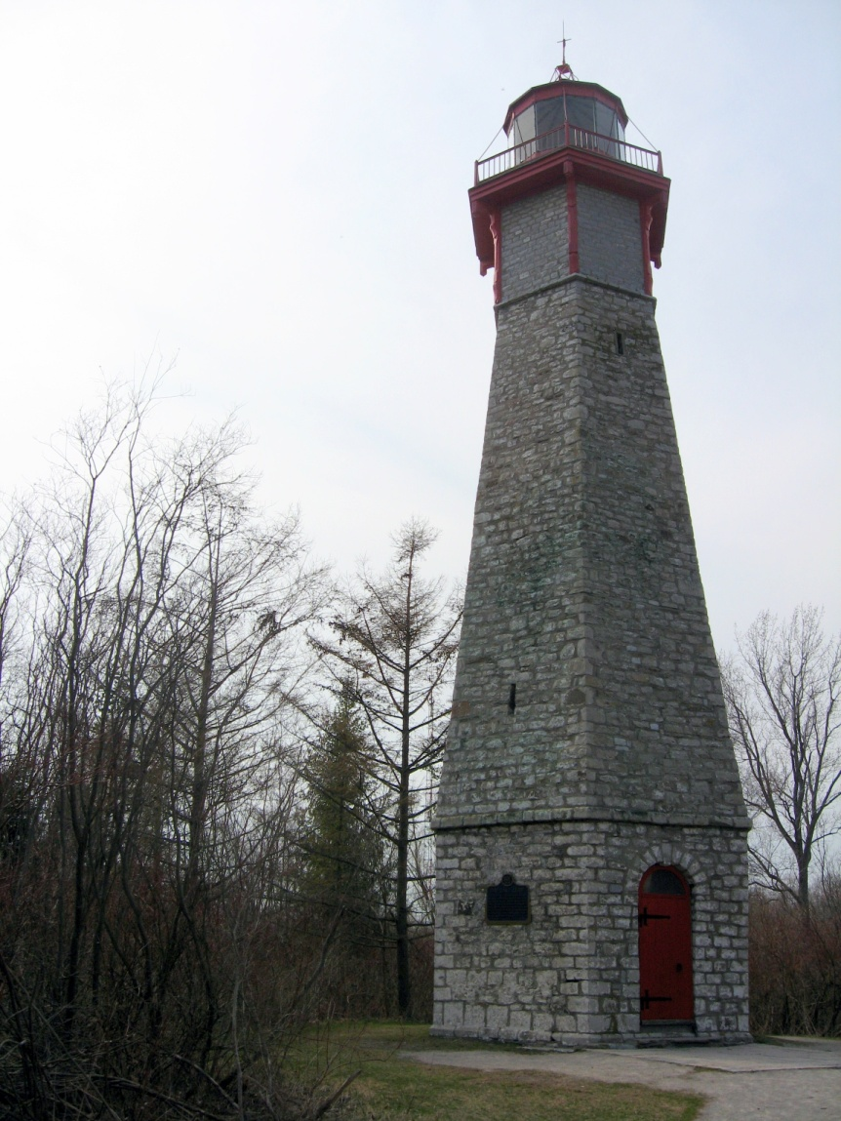
Yet more haunted Toronto locations
Gibraltar Point Lighthouse on Toronto Island, the ghost of the murdered lighthouse keeper roams around
The Elgin and Winter Gardens Theatre has a haunted elevator
St Michael’s Hospital has a nurse ghost roaming the halls

Slide 26
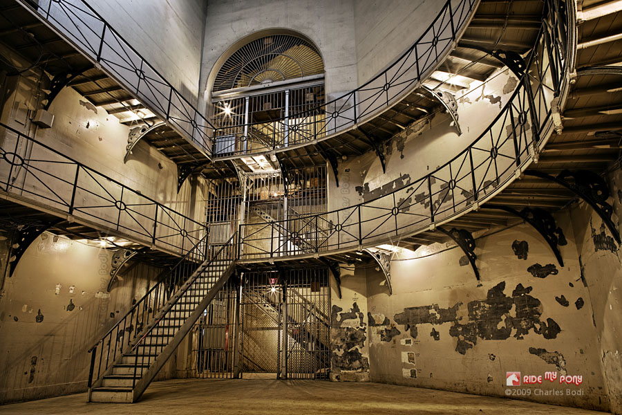
And a few more....
At the old Don Jail, where there were executions and unmarked grave sites, people have seen a hanged woman ghost

Slide 27
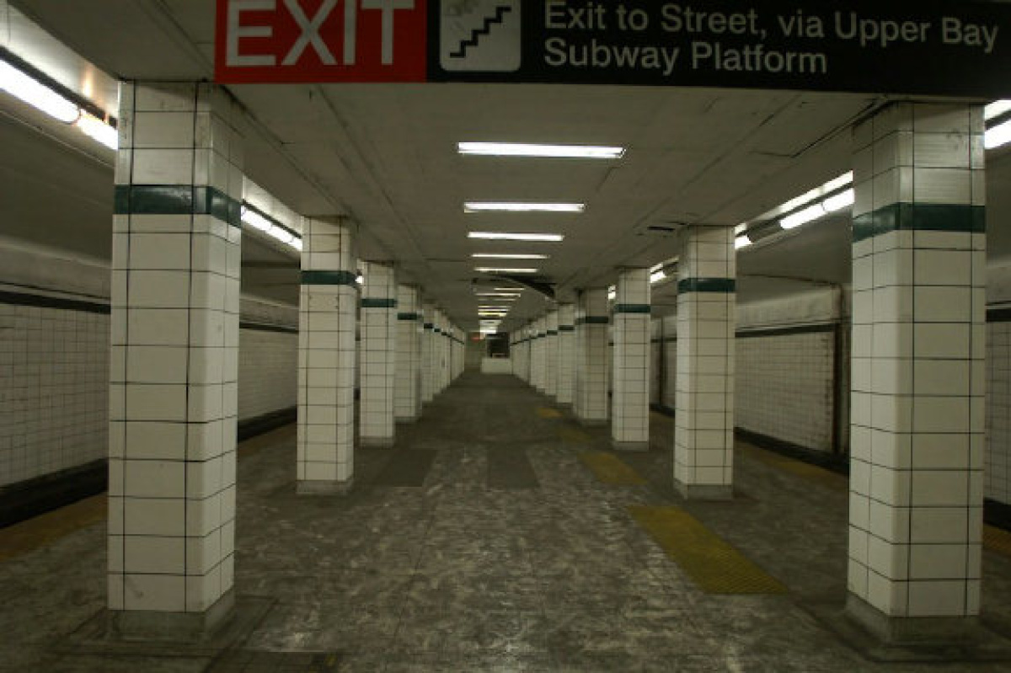
Lower Bay Station, a closed-off old subway station has a legless female ghost floating around

Slide 28
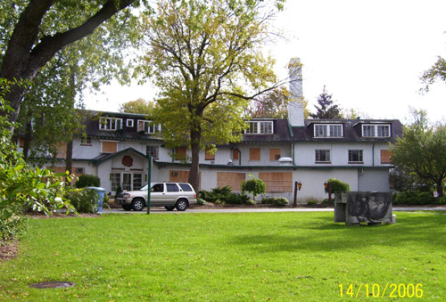
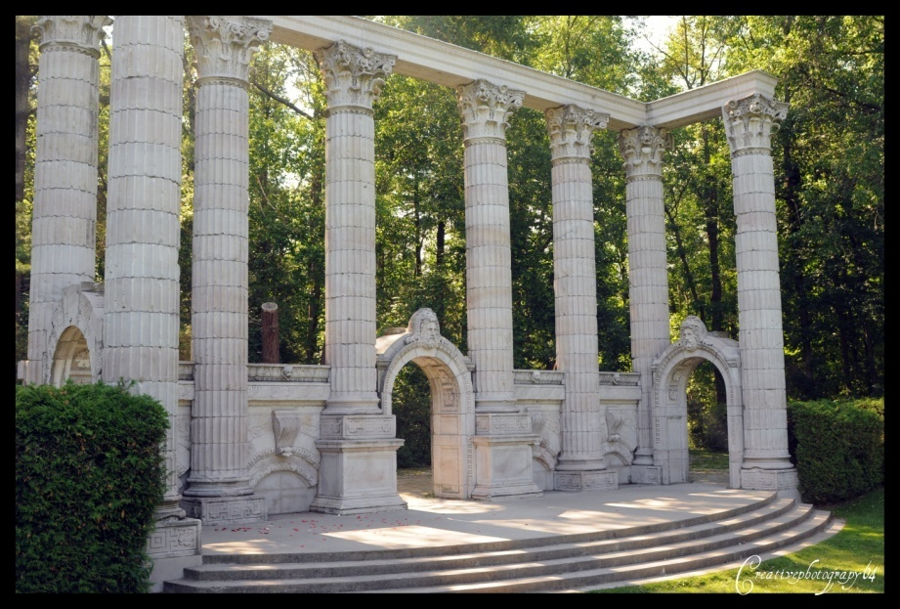
Haunted Scarborough
Many people have seen creepy things in Guildwood Park
RH King School has a female ghost, people have sometimes smelled her perfume
There are stories about a haunted bridge where a girl drowned near Morningside and Old Finch

Slide 29
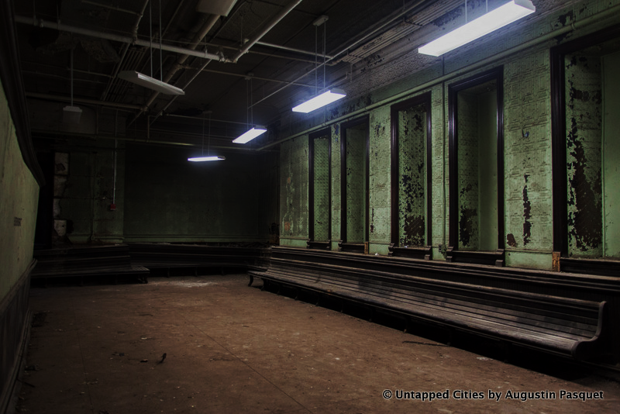
And even…Northern!
The interior courtyard is apparently haunted; there are rumours of a grisly shooting accident in the 1950s
The chairs in the middle will always go back to their original positions in a circle
There is a secret hatch somewhere that exits from the abandoned shooting range in the basement

Slide 30
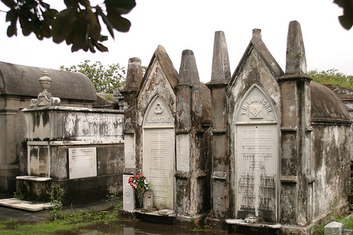
Most Haunted Places on Earth

Slide 31
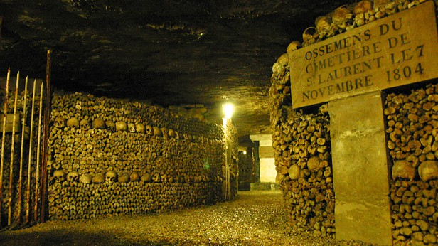
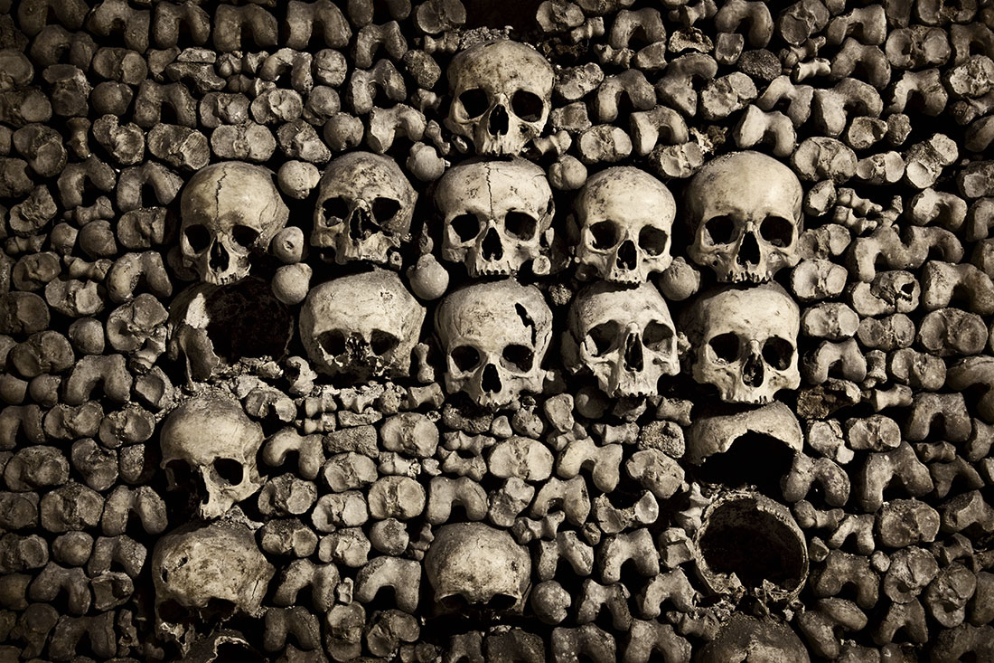
The Catacombs of Paris
It is a vast underground network of tunnels that holds the remains of more than 6 million people
Most of the tunnels are closed to the public, but you can visit the Catacombs
The Catacombs were formed at the end of the 1700s when the main city cemetery was full and the bodies were relocated to the Catacombs, where they were collected and fashioned into elaborate walls and pillars of skulls and bones.
Visitors to the subterranean site have reported the feeling of being touched by invisible hands, being followed, and some have even felt the sensation of being strangled

Slide 32
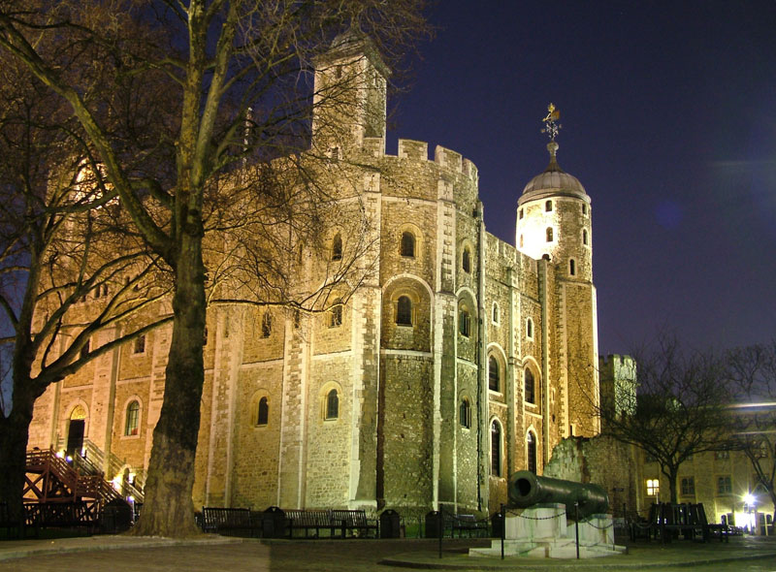
The Tower of London
Historically known as the prison for British royalty, mass executions, tortures, and murders have occurred on this land.
Every year, tourists and locals claim to see ghosts appearing by tower windows.
The ghost of Lady Jane Grey, who was beheaded, has been seen by night guards on the same date of her death, February 12th.
Others report seeing Henry VI’s wife, Ann Boleyn, who was also beheaded . Ann is seen frequently, sometimes carrying her own head.

Slide 33
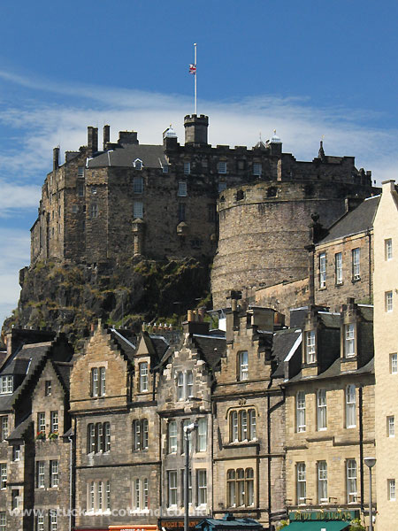
Edinburgh Castle, Scotland
Scotland’s Edinburgh Castle has some 900 years of tragic history, the source of much paranormal activity today.
As a military fortress, the castle has experienced many surprise attacks, executions, mass body burnings, and even instances of witchcraft.
Recently, in 2001 the castle became the site of one of the largest paranormal investigations in history — more than 200 people scoured its chambers and secret passages for signs of ghosts. According to Time, 51% of the participants reported paranormal encounters (shadowy figures, drops in temperature, and physical touches) in rumored haunted areas.

Slide 34
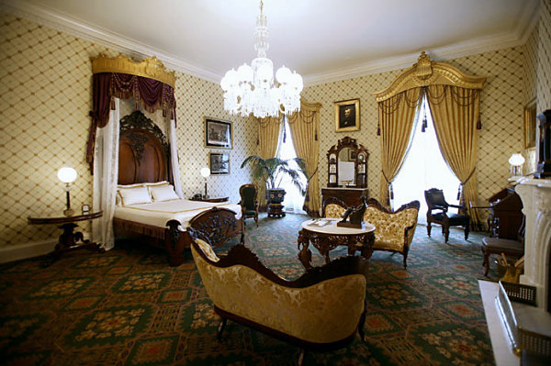
The White House, USA
1600 Pennsylvania Avenue, the most famous address in America, is also a popular place where the ghosts of past presidents have been sighted.
By far the most frequently reported sighting over the years is Abe Lincoln, who was shot in April 1865. His ghost made numerous appearances during the administration of Franklin D. Roosevelt; First Lady Eleanor Roosevelt, Queen Wilhelmina of the Netherlands, and Winston Churchill all came into paranormal encounters with Lincoln’s ghost.

Slide 35
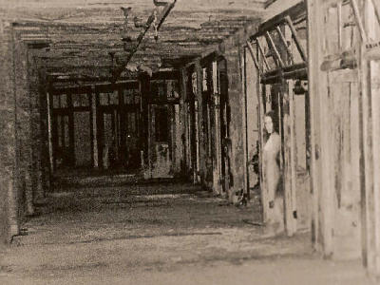
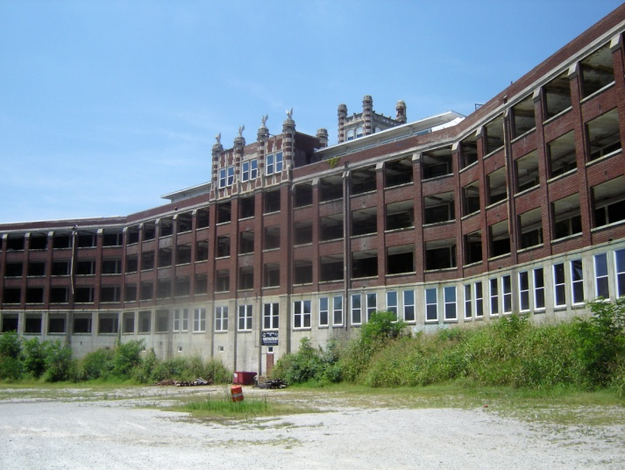
Waverly Hills Sanatorium,
Louisville, KY
In the 1930s and 40s, thousands of people died here from tuberculosis
To deal with the escalating death toll, hospital workers removed dead bodies from the facility via an underground tunnel that led to the back of the building. The so-called "death chute" is now a key attraction on the ghost tour of Waverly Hills
There are varying reports, including apparitions, fleeting shadows, screams from empty rooms, footsteps, sudden cold spots, and disembodied voices among many others
Every Halloween, they hold a ‘haunted house’ there

Slide 36
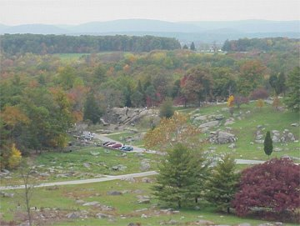
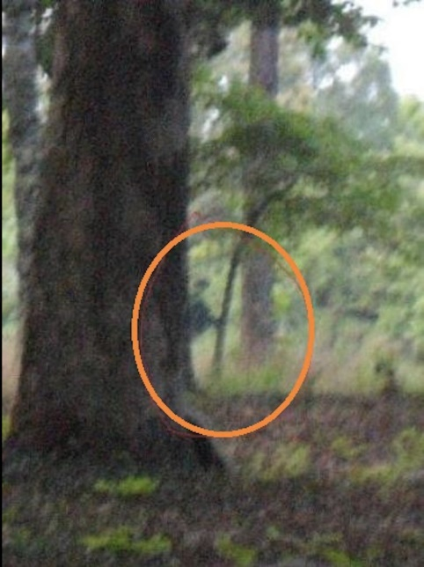
Gettysburg, Pennsylvania
During the American Civil War this place was a battlefield where 51,000 people were wounded or killed
Today is very haunted and people have seen soldier ghosts on the field
On the ghost tour, visitors have experienced everything from touches, smells and sounds to spotting unusual figures lurking in the distance.

Slide 37
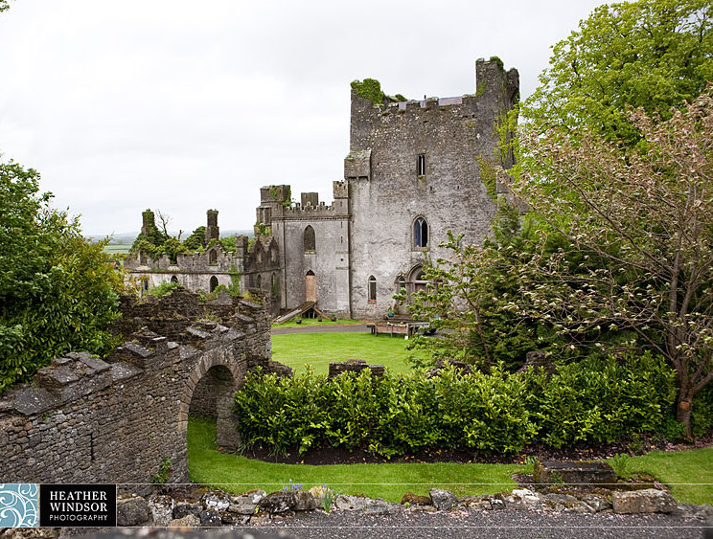
Leap Castle, Ireland
A bloody family feud led to one brother murdering the other in front of their family in what they now call the ‘Bloody Chapel’
The castle is rumored to be haunted by a vast number of spirits, including a violent, hunched beast known only as the Elemental.
While renovating the castle, workers discover a dungeon that contained three cartloads of human remains, and was filled with spikes to impale those thrown into its depths

Slide 38
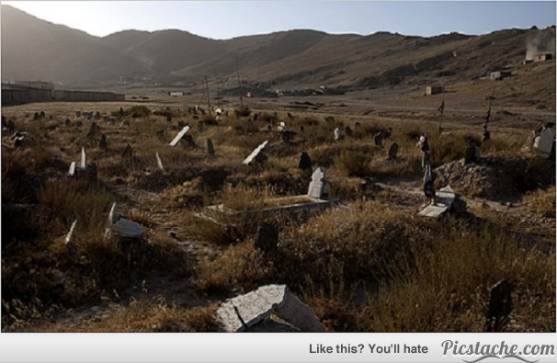
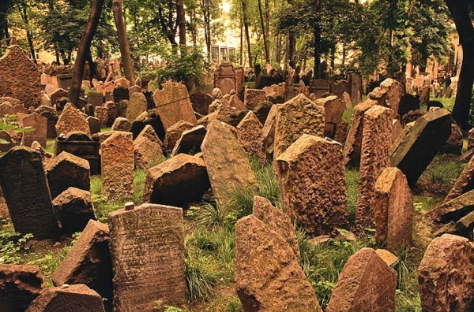
Lanoria, Chile
This abandoned mining town is so terrifying that nearby residents refuse to go there
It is rumored that the dead of the La Noria cemetery rise at night and walk around the town and children have been heard playing.
The cemetery of La Noria, regardless of whether its occupants actually walk at night, contains opened graves where the bodies are fully exposed, leaving you to wonder why.

Slide 39
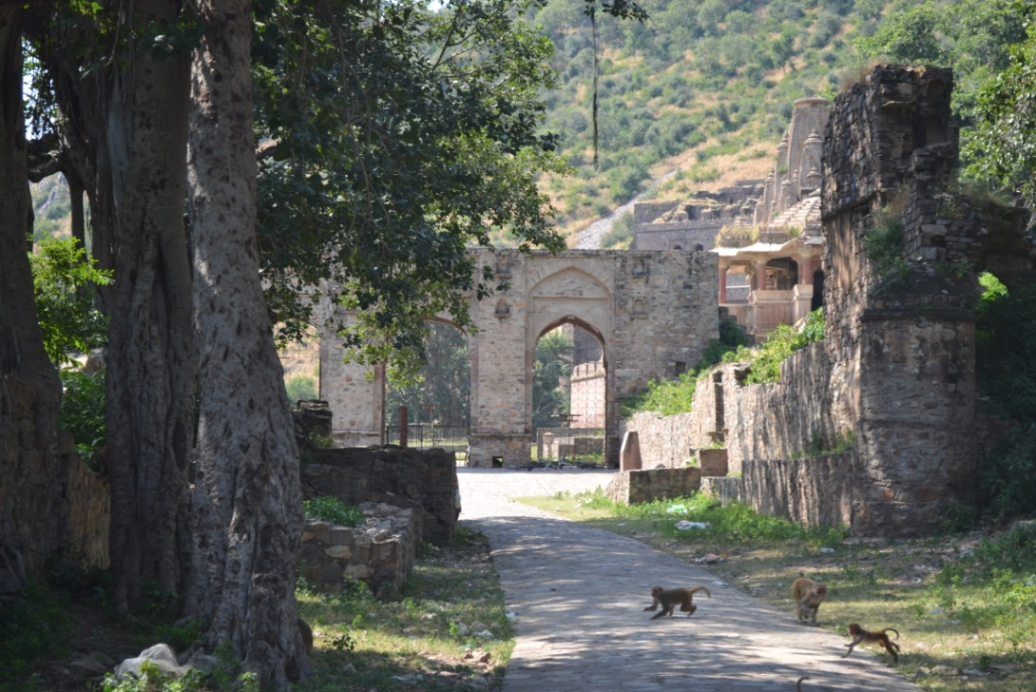
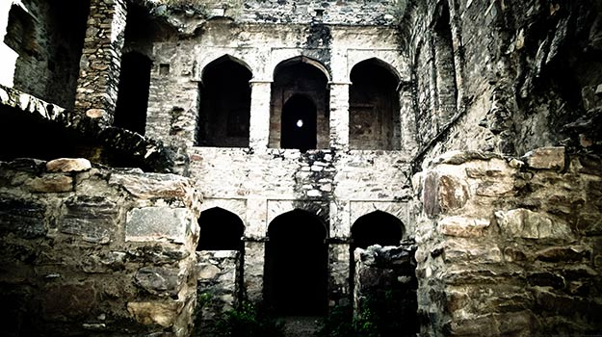
Banghar Fort, India
It is actually an entire city in Rajasthan, India
“Most haunted place in India”
Locals rarely visit and the owners of the property forbids visitors from staying after sunset
There are a few legends as to how the city became cursed, most involving black magic
Either way, locals believe the town is still cursed and that the ghosts of the 10,000 people who lived in the fort now haunt its premises.
The fort is believed to be the most haunted place in India and many believe that anyone who stays there after dark will never return from the village.

Slide 40
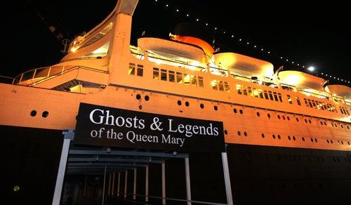
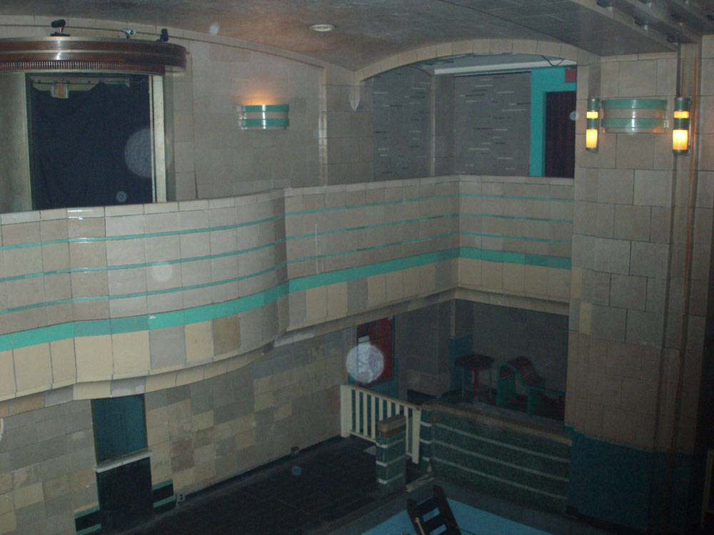
The Queen Mary, California
RMS Queen Mary is an ocean liner that sailed the North Atlantic Ocean from 1936 to 1967
It was purchased by the city of Long Beach, California in 1967 and transformed into a hotel.
The most haunted area of the ship is the engine room where a 17-year-old sailor was crushed to death trying to escape a fire. Knocking and banging on the pipes around the door has been heard and recorded by numerous people.
In what is now the front desk area of the hotel, visitors have seen the ghost of a “lady in white.” Ghosts of children are said to haunt the ship’s pool.

Slide 41
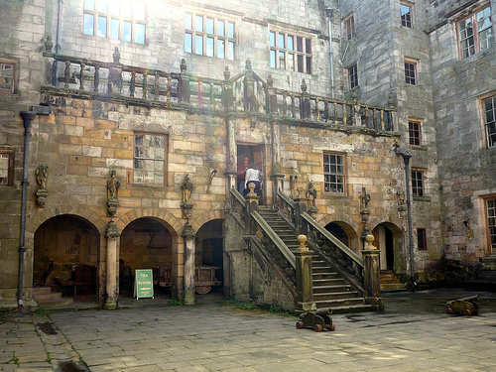
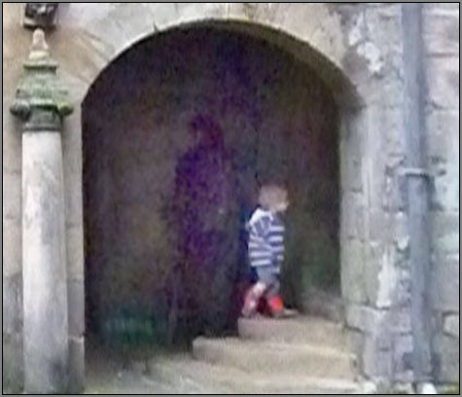
Chillingham Castle, England
Chillingham Castle in England is most famous for its ghosts and is marketed as the most haunted castle in Britian.
The most frequently seen ghost of castle is the “blue boy”. Guests of the Pink Room have reported seeing blue flashes of light or a blue halo of light above their bed after a long loud wailing.
The hauntings decreased or perhaps ceased after renovation work revealed two bodies, a man and a young boy who were both bricked inside a 10-foot thick wall.
The owners however claim the hauntings continue, so ghost hunters and paranormal investigators still come to investigate the mysteries of Chillingham Castle.

Slide 42
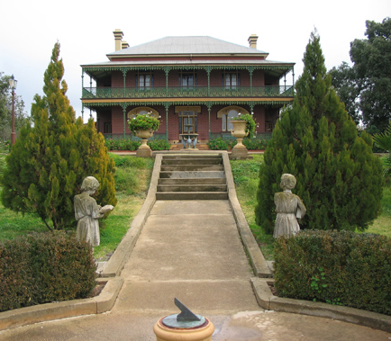
Monte Cristo Homestead, Australia
The most haunted spot in Australia
Many people have died there, including a young child who was dropped down the stairs, a maid who fell off the balcony, a stable boy who burned to death, and a caretaker that was murdered
One caretaker chained his disabled son up there for 40 years

Slide 43

Castle of Good Hope,
South Africa
A colonial building from the 1600s
A soldier hung himself in the bell tower, now the bell sometimes rings itself
Other ghosts include a large black dog and a weeping Woman in Grey
A soldier put a curse on the Governor who had sentenced him to death, the Governor was found later that day, dead at his desk with a look of terror on his face

Slide 44


Fort George, Halifax Citadel, Canada
Canada’s most haunted place, hundreds of eerie sightings every year
Reports of soldier ghosts, a woman who appears in mirrors, a little girl who joins the tour groups and holds people’s hands, the feeling of being watched or nudged

